Slide 1
ITE TECHNICAL SESSION | ADAPTIVE SIGNAL CONTROL
Camarillo AI Adaptive Project
Why we modernized, how Miovision Surtrac works, and test bed results after one month on Arneill Road
City of Camarillo, California — Traffic Engineering
Arneill Rd corridor · ~230,000 signal cycles · August 14 – September 14, 2026
Notes:
TIME BUDGET: Part 1 about 7 minutes, Part 2 about 9, Part 3 about 12, then questions.
Good morning. Three parts. First, why a city of 70,000 in Ventura County decided it needed adaptive signal control, which starts with a wildfire. Second, how the technology actually works, because adaptive gets used as a marketing word and I want you to leave knowing what the algorithm does. Third, a one-month natural experiment on a four-signal corridor in Camarillo, California. Over that month our adaptive system was in control about 83 to 85 percent of the time; the rest of the time the signals fell back to time-of-day coordinated patterns. That gave us a paired on/off comparison without staging a field study.
Two things to flag up front, and I will come back to both: the coordinated hours were not randomly assigned, and adaptive state was inferred from controller operation, not from a vendor on/off flag. These are descriptive comparisons, not a controlled trial.

Slide 2
AGENDA
Thirty minutes, three parts
1
Why Camarillo modernized
~7 min
November 6, 2024. What a wildfire evacuation did to a signal network running on grid power and fixed timing plans, and the capital program that followed.
2
How AI adaptive control works
~9 min
Detection, scheduling and coordination in Miovision Surtrac. What the algorithm is doing second by second, and what it is not doing.
3
Test bed results after one month
~12 min
Natural on/off operation on the Arneill Road test bed: delay, pedestrians and emissions.
Questions at the end. The method in Part 3 is reproducible with data most agencies already collect.
Notes:
Three parts, and they build on each other. Part one is the why. Part two is the how, and that is the part I was asked to spend real time on. Part three is the evidence, which is where I will spend the most time because it is the part nobody publishes honestly.
If you only take one thing away, I want it to be the method in part three.

Slide 3
PART ONE
Why Camarillo modernized
A signal network is infrastructure until the day it is emergency infrastructure.
Notes:
Part one. I am going to start somewhere that has nothing to do with delay per vehicle.

Slide 4
NOVEMBER 6, 2024
The Mountain Fire
9:00 a.m.
19,904
243 / 127
~14,000
Ignition near Balcom Canyon
and Bradley Road, Somis
acres burned before
100% containment on Nov 27
structures destroyed
and damaged
Ventura County residents
under evacuation notice
Santa Ana winds drove the fire from Somis into Camarillo Heights and Camarillo Estates within hours. At the peak of the event roughly 42,000 Southern California Edison customers in the county were without power.
PHOTO
Mountain Fire, Camarillo, November 2024.
Drop your own or a CAL FIRE image here.
Sources: CAL FIRE incident reports; Ventura County Sheriff's Office of Emergency Services.
Notes:
November 6th, 2024. The Mountain Fire started just before nine in the morning near Balcom Canyon and Bradley Road in Somis. Santa Ana winds pushed it southwest, across Highway 118, into Camarillo Heights and Camarillo Estates.
Final numbers: just under 20,000 acres, 243 structures destroyed, 127 damaged, around 14,000 people under evacuation notice. At the peak, about 42,000 utility customers in the county were without power.
I am not here to talk about the fire. I am here to talk about what a city's traffic signal network does on a day like that, because that is the day the network stops being a convenience and becomes life safety infrastructure.

Slide 5
WHAT THE NETWORK DID
Las Posas went dark
▪ The signals along Las Posas Road went dark. Grid power was lost and there was no backup at the cabinet. Under California Vehicle Code 21800(d) a dark signal is legally an all-way stop, and drivers treat it as one only some of the time.
▪ No timing plan was running at all. Not adaptive, not coordinated, not free. A dark signal is not a signal running the wrong plan. It is no signal, and nothing in the cabinet was managing evacuation demand.
▪ Staff had no remote visibility. Without central monitoring or camera feeds, knowing what a corridor was doing meant sending someone to stand at it.
▪ The only lever was manual. Officers directing traffic at intersections, which pulls sworn personnel off evacuation and structure defense at the exact moment they are scarcest.
The result
Gridlock on the city's busiest corridors during an active evacuation.
Two of those problems are solvable with equipment. The other two are solvable with software.
Notes:
Four things happened at once, and they compound.
One, the signals along Las Posas Road lost power and went dark. In California a dark signal is legally an all-way stop. Drivers comply with that inconsistently under normal conditions and worse under stress.
Two, and be precise about this because it is the part people get wrong: there was no timing plan running. Not a bad plan, not a stale plan. No plan. The cabinet was dead, so nothing was managing evacuation demand on that corridor.
Three, we had no remote visibility into what corridors were doing.
Four, the only remaining tool was manual control, which costs you officers at the worst possible moment.
The outcome was gridlock on our busiest corridors during an active evacuation. I want to be careful here: I am describing operating conditions, not assigning fault. The equipment performed the way equipment of that generation performs when the grid goes down.

Slide 6
THE RESPONSE
What Camarillo has built since
Opticom emergency preemption
Super capacitor battery backup
Complete at all City-owned signals. Six remaining locations on Caltrans right of way at Lewis Road (SR 34).
Signals stay in normal operation through an outage instead of going dark. Better heat tolerance and service life than lead acid.
AI adaptive video detection
CMAQ federal grant, 65 intersections
Arneill Rd corridor. Replaced legacy loop and video detection, and added live remote visibility into field conditions.
AI adaptive video, battery backup and new ATC controllers citywide. The largest resiliency investment in the network.
Fusus camera integration
Municipal traffic cameras into the public safety platform for situational awareness during incidents and closures.
Backup power keeps the signal alive. Adaptive control is what makes the surviving signal useful when demand stops looking like a Wednesday.
Notes:
Here is the program. Preemption, backup power, adaptive detection and control, the CMAQ grant that scales it to 65 intersections, and camera integration with public safety.
And notice the logic of the stack. Backup power keeps the signal alive. But a live signal running a plan written for an average Wednesday is still the wrong plan during an evacuation. Adaptive is the piece that makes the surviving signal responsive. That is why the resiliency argument and the congestion argument end up pointing at the same purchase.

Slide 7
PART TWO
How AI adaptive control works
Detection, scheduling and coordination. What Surtrac is doing second by second.
Notes:
Part two. This is the part I was asked to explain properly, so we are going to get into the algorithm.

Slide 8
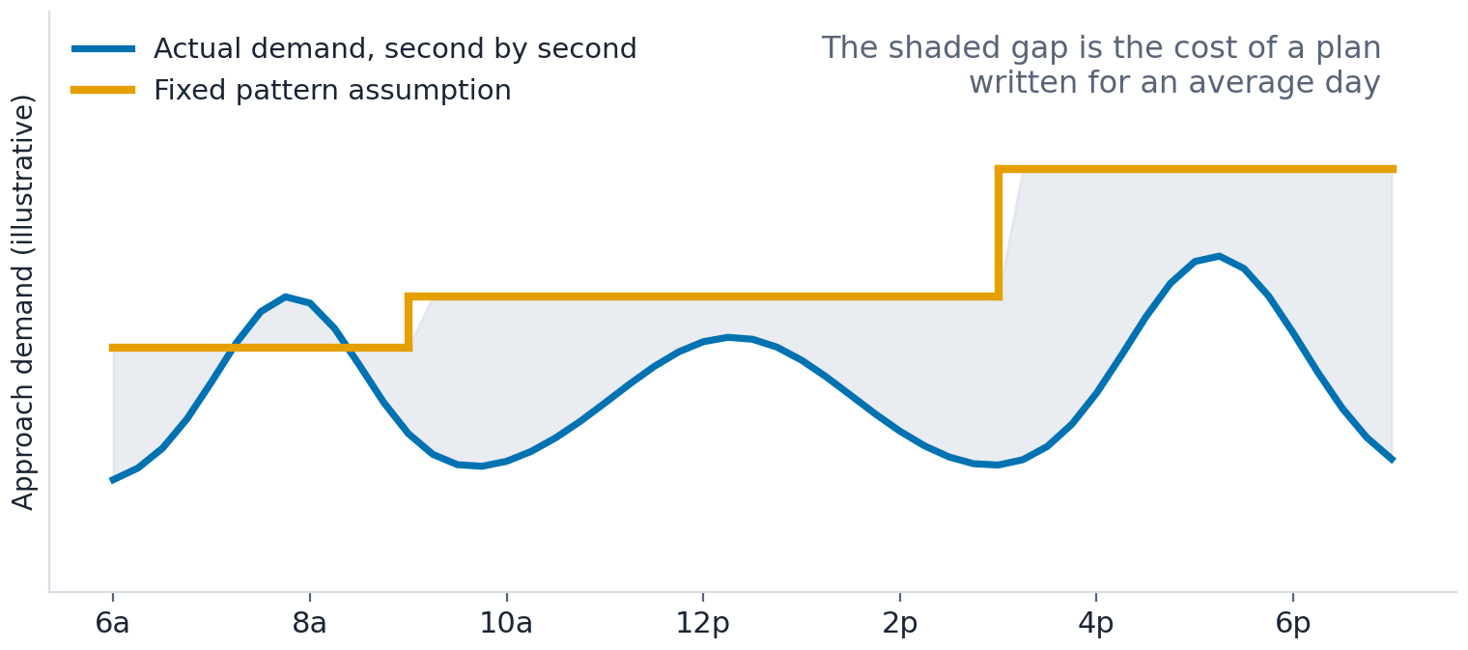
THE BASELINE
Fixed and coordinated control is a plan written for an average day
What we do today
An engineer studies counts, builds a handful of time-of-day patterns, and the controller runs whichever one the clock says.
The plan is right on the average day it was built from, and progressively wrong on every other one. It ages, and nothing in the cabinet tells you it is aging.
Retiming is the accepted fix. In practice most agencies retime on a multi-year cycle, if at all.
Illustrative, not measured data.
Notes:
Start with what almost all of us run. An engineer collects counts, builds three or four time-of-day patterns, and the controller picks one based on the clock.
That plan is correct for the average day it was derived from. Every other day it is approximately wrong, and the error grows as land use and travel patterns change. Nothing in the cabinet tells you that it is drifting.
The accepted answer is periodic retiming. Be honest about how often that actually happens at your agency. For most of us it is a multi-year cycle, and it is the first thing cut when the budget tightens.
Adaptive control is a different answer: stop writing plans and start solving the problem in real time.

Slide 9
LAYER ONE: DETECTION
The camera stops being a loop replacement
1
Legacy loops and video
2
AI video detection
Presence and call. A binary: is there metal or motion over this zone. The controller learns that a phase has demand, nothing more.
Objects are detected, classified and tracked across the field of view: vehicles, bicycles, pedestrians, and where each one is right now.
3
What that gives the algorithm
4
It is shared, not just local
Approaching platoons with position, speed and size, not just a call. That is the input adaptive control needs and legacy detection cannot supply.
What one intersection sees does not stay there. Vehicle data is passed to the neighboring signals, so each one knows what is heading its way before it arrives.
Adaptive control is only as good as what it can see. Detection is not a line item to value engineer out of the project.
Notes:
Adaptive has two layers and people conflate them. This is the first: detection.
A loop, or legacy video emulating a loop, answers one question. Is something in this zone. That is a call. The controller knows the phase has demand and nothing else.
AI video detection classifies and tracks objects across the whole field of view. It knows there are eleven vehicles approaching, where they are, how fast, and that two of them are bicycles. That is a fundamentally richer input.
And this matters commercially: the scheduling algorithm we are about to discuss cannot do anything useful with a binary call. If you value engineer the detection out of an adaptive project, you have bought an expensive fixed-time controller.
And the fourth box is what makes it a network instead of four smart boxes. What one intersection detects gets passed to the neighboring signals, so the next signal down the corridor knows what is coming before a vehicle reaches its own detection zone. Hold onto that, because it is the mechanism I come back to two slides from now.

Slide 10
LAYER TWO: THE ALGORITHM
Surtrac treats an intersection as a scheduling problem
It is single-machine scheduling
The intersection is the machine. Approaching platoons are jobs waiting to be processed. Each phase change is a setup cost, paid in yellow and all-red.
The algorithm sequences the jobs to minimize cumulative delay across all approaches, subject to the constraints the cabinet already enforces.
That framing is why it handles the things fixed plans handle badly: a lane closure, a double-parked truck, an incident, or an evacuation surge. None of those need a stored pattern. They just change the jobs in the queue.
PHOTO
Miovision camera, cabinet or intersection.
Drop your own project photo here.
The reframe
Most systems ask which stored plan fits best right now. Surtrac asks a different question: given the vehicles I can see approaching, what sequence of phases clears them with the least total delay?
Notes:
Surtrac stands for Scalable Urban Traffic Control. It came out of Carnegie Mellon, was commercialized by a spinout called Rapid Flow Technologies, and Miovision acquired them. So when you see Miovision Surtrac or Miovision Adaptive, that is the lineage.
Here is the core intellectual move, and it is genuinely elegant. Forget signal timing for a second. Think of the intersection as a single machine on a factory floor. Platoons of vehicles are jobs arriving to be processed. Switching phases is a setup change, and you pay for it in yellow and all-red time.
Now it is a scheduling problem, and scheduling problems have well understood solutions. Sequence the jobs to minimize total delay, subject to your constraints.
The reason this matters operationally: a lane closure or an evacuation surge does not require a new plan. It just changes what is in the queue, and the scheduler responds.

Slide 11
THE LOOP
Four steps, repeated every second
1
2
3
4
Detect
Schedule
Execute
Recompute
Build clusters of approaching vehicles from the detection feed: how many, where, how fast.
Solve for the phase sequence over a rolling horizon, typically the next minute or two, that minimizes cumulative delay.
Commit only the first decision. Hold the current phase or change it now.
Throw the rest of the schedule away and solve again with a second of fresher data.
Why commit only the first decision?
Because the schedule past the first move is a prediction, and predictions decay. Solving a fresh problem every second is cheaper than being wrong for the next ninety.
Notes:
This is the loop, and it runs on the controller at every intersection.
Detect: group approaching vehicles into clusters. Schedule: solve for the phase sequence over a rolling horizon, on the order of the next minute or two, that minimizes cumulative delay. Execute: commit only the first decision, hold or change. Recompute: discard the rest and solve again a second later.
The rolling horizon is the part worth understanding. It plans two minutes out but only ever acts on the next second, because everything past the first decision is a forecast and forecasts decay. It is cheaper to re-solve every second than to be committed to a ninety second cycle that stopped being right forty seconds ago.
Compare that to coordinated control, where you commit to an entire cycle and a fixed offset before the first vehicle arrives.

Slide 12
COORDINATION WITHOUT A COMMON CYCLE
Each intersection tells its neighbor what is coming
Intersection A
Intersection B
Intersection C
Solves its own
schedule locally
Solves its own
schedule locally
Solves its own
schedule locally
projected
outflow
projected
outflow
▪ Forward: the plan becomes the neighbor's forecast. When an intersection commits a schedule it knows when vehicles will be released downstream. It sends that projection to the next intersection, which treats it as predicted arrivals and schedules around it.
▪ Backward: softpressure. Downstream intersections report queue conditions upstream, so an intersection will not discharge a platoon into a link that is already saturated.
▪ No central computer, no common cycle. Every intersection solves its own problem and exchanges information with its neighbors. That is what decentralized means, and it is why the approach scales to a grid rather than only a corridor.
Notes:
So if every intersection is solving its own problem, what makes it a system rather than three independent signals? Two information flows.
Forward: when an intersection commits a schedule, it knows exactly when it will release vehicles. It hands that projection to the downstream intersection, which treats it as predicted arrivals and schedules around them. That is how you get progression without a common cycle length.
Backward: downstream queue information, which Rapid Flow calls softpressure, prevents an intersection from dumping a platoon into a link that is already full.
There is no central computer making the decisions. That is the architectural difference from older adaptive systems, and it is why this approach works in a grid, not just on an arterial. Keep that word decentralized in mind, because in part three it explains the one result that went against us.

Slide 13
WHAT ADAPTIVE IS NOT
Three corrections, and the safety envelope
It is not a self-tuning cycle.
The safety envelope
Everything underneath is unchanged:
Conflict monitor and MMU
Minimum and maximum green
Yellow change and red clearance
Pedestrian walk and clearance
Emergency vehicle preemption
Preemption still wins. Adaptive schedules inside the cabinet's rules, it does not replace them.
There is no background cycle length being adjusted. There is no cycle at all in the traditional sense; there is a sequence of scheduling decisions.
It is not learning from your history.
It optimizes on vehicles detected right now. It does not train on months of counts and it will not quietly drift toward a bad habit.
It is not a substitute for engineering.
Phase sequence, clearance intervals, pedestrian timing, detection design and safety review are still yours. The algorithm schedules within what you allow it.
If a vendor cannot tell you which of these it respects, that is your answer.
Notes:
Three corrections, because these are the misconceptions I hear most.
It is not a self-tuning cycle length. There is no background cycle being nudged. There is no cycle in the traditional sense at all.
It is not machine learning on your historical counts. It optimizes on what is detected right now. That is actually reassuring from a liability standpoint: it is not going to develop a habit you did not authorize.
And it is not a substitute for engineering judgment. You still own phase sequence, clearance intervals, pedestrian timing and detection design.
The panel on the right is the question I get from every skeptical technician, and it is the right question. Everything in the cabinet still applies. Conflict monitor, minimum green, yellow and red clearance, pedestrian timing, preemption. Preemption still wins. Adaptive schedules inside the envelope, it does not replace it.

Slide 14
WHAT ELSE THE DETECTION LAYER BUYS
Safety tools that come with the same cameras
Pedestrian red extension
Red light running analytics
If someone is still in the crosswalk when clearance ends, the camera sees them and the red holds. Slower pedestrians get the time they actually need instead of the time a formula assumed.
Violations are counted and time stamped by approach and by hour. Timing changes and enforcement requests get made from data instead of from complaints.
Near miss analytics
Video recording
Conflicts that did not become collisions are detected and classified. That is a leading safety indicator, available now rather than after five years of crash history.
Recorded intersection video lets staff review a collision, a complaint or a claim after the fact, without waiting for the condition to happen again.
None of these are adaptive control. They are what you get for free once the corridor can see, and they are usually the easiest part of the project to justify.
Notes:
Before we leave the technology, the part that does not show up in a delay study.
Pedestrian red extension. If the camera still sees someone in the crosswalk when clearance runs out, the red holds. That is real service for older pedestrians, kids, anyone with a mobility device, and it costs you nothing in a timing sheet.
Red light running analytics. Every violation counted and time stamped by approach and by hour. That changes the conversation with PD from anecdote to data.
Near miss analytics. Conflicts that did not become crashes, detected and classified. This is the one I would sell hardest, because the alternative is waiting for a crash history to accumulate before you are allowed to act.
And recorded video, so when a claim or a complaint comes in you can go look instead of sending someone out to wait for it to happen again.
None of this is adaptive control. It is what comes with the cameras, and in my experience it is the easiest part of the package to get funded.

Slide 15
PART THREE
Test bed results
One month of natural on/off operation on the Arneill Road test bed.
Notes:
Part three, and this is the part I would most like you to steal.

Slide 16
WHY ARNEILL ROAD
We picked the hardest corridor we had
1
Four tightly spaced signals
2
A fire station right off the corridor
Barry, Daily, Pickwick and Ponderosa sit close together. Tight spacing is exactly where fixed coordination struggles: a common cycle and offset that works for one pair breaks the next pair.
Preemption fires multiple times a day. Every preempt throws a coordinated corridor out of step, and it takes several cycles to recover the offsets.
3
Heavy pedestrian demand
4
Two of the four cross arterials
Nearly 17,800 walk phases across four signals in a single month. Pedestrian service and vehicle progression pull directly against each other here.
Daily Dr and Ponderosa Dr are arterials in their own right. On this corridor the minor street is not a quiet side street, it carries real volume.
This was not a corridor chosen to make adaptive look good. If it could not show a benefit here, it was not going to show one anywhere in Camarillo.
Notes:
First question I always get: why this corridor. Four reasons, and none of them is that it was easy.
One, four signals packed close together. Tight spacing is where fixed coordination has the hardest time, because an offset that serves one pair well breaks the next one.
Two, we have a busy fire station right off the corridor. Preemption runs multiple times a day, and every single preempt knocks a coordinated corridor out of step. You spend the next several cycles recovering.
Three, heavy pedestrian demand. Almost 17,800 walk phases in a month across four signals. Pedestrian service and progression are in direct tension here.
Four, and this matters for how you read the results: two of the four cross streets, Daily and Ponderosa, are arterials themselves. So when I say minor street later in this talk, do not picture a quiet residential leg.
This was the hardest corridor we had. That was the point.

Slide 17
WHY THIS STUDY
Adaptive is usually judged by a before/after study.
This month handed us a paired comparison.
1
2
3
The usual method
What happened here
Why that matters
Deploy adaptive, compare a period before against a period after. Season, construction, demand growth and detector changes all move between the two.
Adaptive ran roughly 84% of weekday hours. The remaining 500+ hours reverted to coordinated patterns 1–4, interleaved across the same month.
Both modes are exposed to the same corridor, the same season and largely the same demand profile, a within-month comparison, not across years.
Notes:
Most adaptive evaluations are before/after studies, and they inherit every confounder that moves between the two periods. Here the modes alternate inside a single month on a single corridor, so season and geometry are held fixed.
What we give up is random assignment. Coordinated hours happened when the system fell back, and fallback is not random. Slide 12 covers that in full.

Slide 18
SITE AND METHOD
Four signals, two data streams, no field crew
THE CORRIDOR
MODE
Cabinet coordination telemetry: controller running free vs. reverting to time-of-day pattern 1–4
Arneill Rd & Barry St
Arneill Rd & Daily Dr
OUTCOMES
Arneill Rd & Pickwick Dr
Cycle-level signal performance measures: vehicle delay, arrivals on green, pedestrian phase wait
Arneill Rd & Ponderosa Dr
Weekdays only, 07:00–19:00, the only window where both control modes occur.
SAMPLE
~230,000 signal cycles; 2,553 adaptive hours vs. 503 coordinated hours; 17,757 pedestrian walk phases
Arneill Rd corridor, Camarillo CA — weekdays 07:00–19:00, Aug 14–Sep 14 2026; cycle-level signal performance data.
Notes:
Four signals on Arneill Road: Barry, Daily, Pickwick and Ponderosa. Weekdays 7 to 7, because that is the only window where we observed both modes.
Two independent data streams. Coordination telemetry from the cabinet tells us whether the controller was running free or had reverted to a time-of-day pattern; that is our proxy for adaptive on versus off. Cycle-level performance data gives us the outcomes. About 230,000 cycles, 2,553 adaptive hours against 503 coordinated hours.
No field study, no tube counts, no staged shutdown. Everything here already existed in the systems the agency operates.

Slide 19
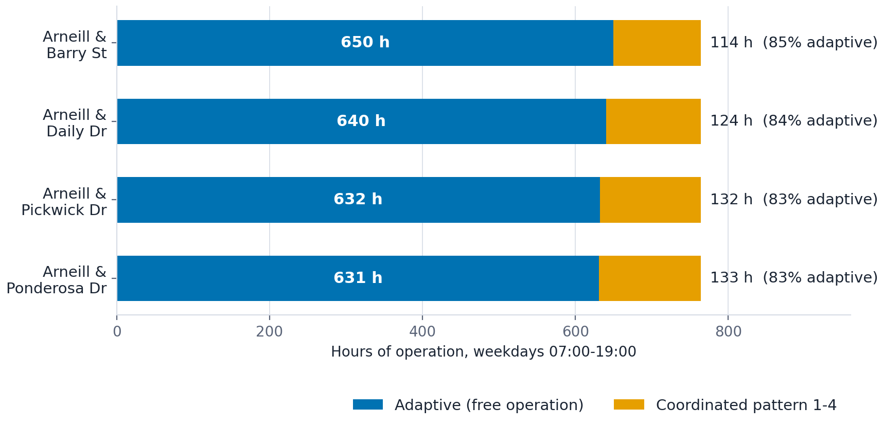
CONTROL-MODE EXPOSURE
83–85% adaptive uptime at every signal
2,553
Adaptive hours
across four signals
503
Coordinated hours
available for comparison
~84%
Weekday hours under
adaptive control
Arneill Rd corridor, Camarillo CA — weekdays 07:00–19:00, Aug 14–Sep 14 2026; cycle-level signal performance data.
Notes:
Uptime was high and consistent: 83 to 85 percent adaptive at every signal. Barry had the most adaptive time, Ponderosa the least, but the spread is small.
The important number is the orange bar. Roughly 120 to 130 hours per signal, about 500 hours in total, ran on coordinated patterns. That is a large enough sample to compare against, even though it is one fifth the size of the adaptive sample. Unequal sample sizes are one reason we describe differences rather than test them.

Slide 20
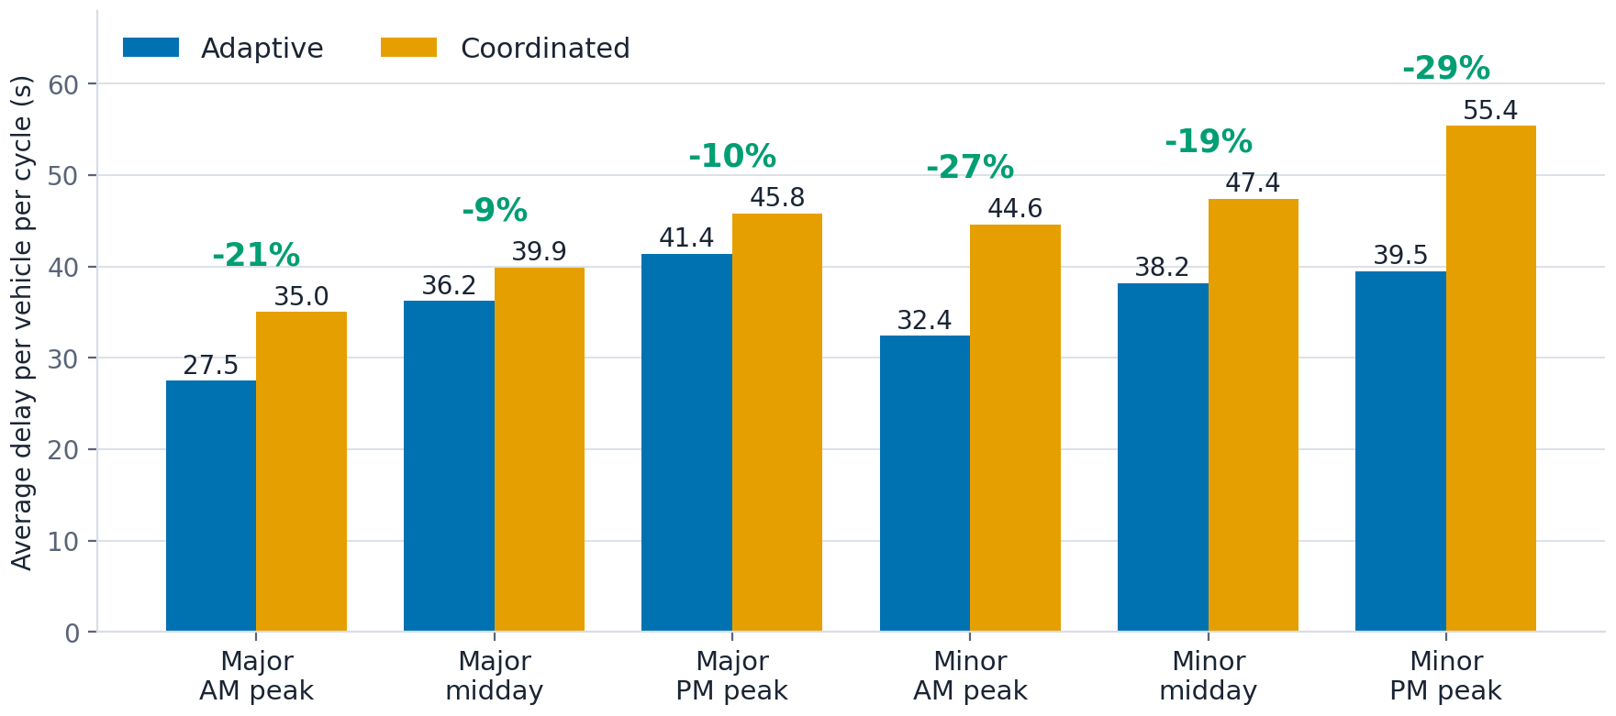
HEADLINE RESULT
Delay fell under adaptive in every comparison
Range of
improvement
9–21%
major street
19–29%
minor street
Largest single gain: minor street PM peak, 55.4 s → 39.5 s per cycle.
Arneill Rd corridor, Camarillo CA — weekdays 07:00–19:00, Aug 14–Sep 14 2026; cycle-level signal performance data.
Notes:
This is the headline. Average delay per vehicle per cycle, split by street class and time period, adaptive against coordinated. Every one of the six comparisons favors adaptive.
Major street improvements run 9 to 21 percent, minor street 19 to 29 percent. The single largest gain is minor-street PM peak: 55.4 seconds down to 39.5 seconds per cycle.
Caveat to state out loud: the coordinated sample is smaller and clustered on particular days, so some of this gap could reflect demand differences rather than control. I am not claiming statistical significance for any of it.

Slide 21
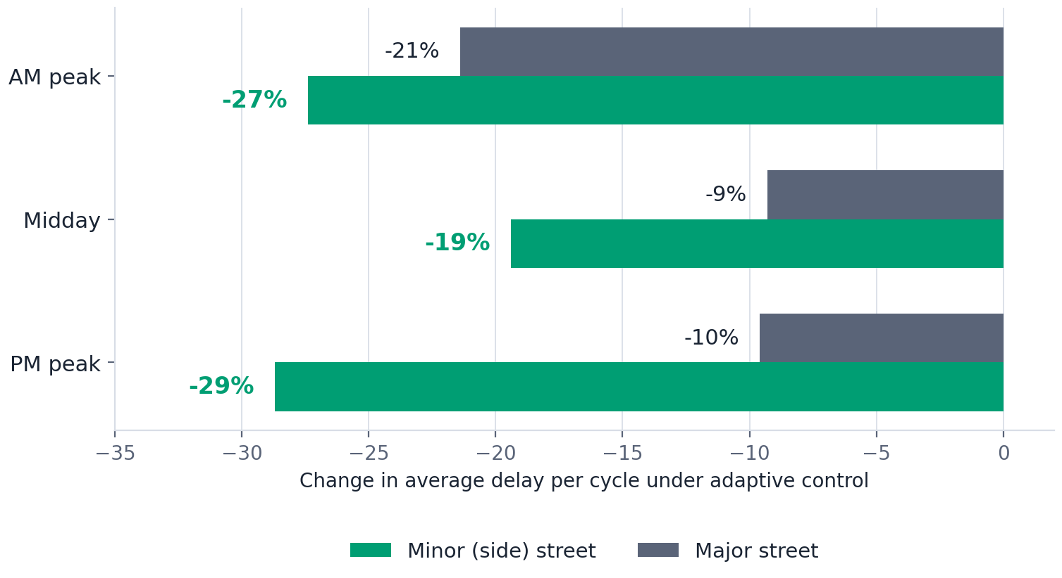
THE EQUITY STORY
Side-street and cross-street users are the biggest winners
Who gains most
Minor-street delay fell 19–29% against 9–21% on the arterial. The larger relative gain lands on the movements that were worst served under fixed patterns.
Under a coordinated background cycle, side streets wait out the arterial's fixed green whether or not traffic is present. Adaptive serves the demand that is actually there.
This is the argument that resonates with a council or a neighborhood group: the people who complain about the corridor are usually on the side street.
Arneill Rd corridor, Camarillo CA — weekdays 07:00–19:00, Aug 14–Sep 14 2026; cycle-level signal performance data.
Notes:
Same delay data, framed by who benefits. Minor-street reductions are larger in both absolute and relative terms than major-street reductions in midday and PM peak.
The mechanism is straightforward. A fixed background cycle allocates arterial green whether the demand is there or not, and the side street absorbs the difference. Demand-responsive control redistributes that.
For agency staff this is the politically useful finding. Complaints about a corridor overwhelmingly come from the cross streets and the driveways, not from through traffic.

Slide 22
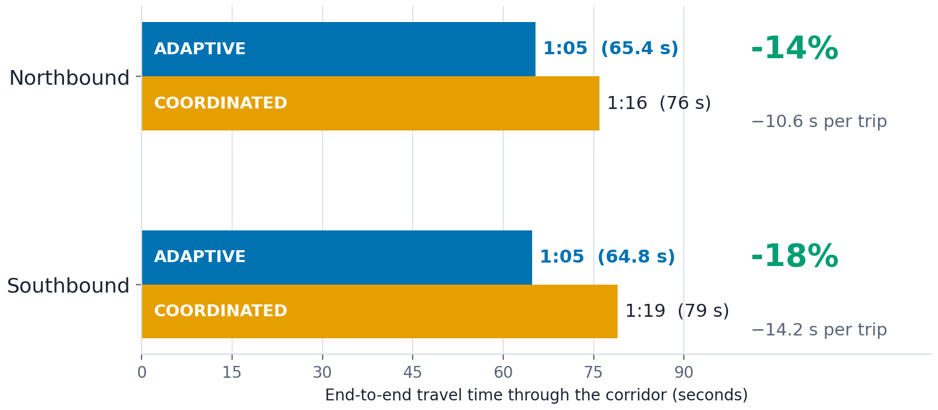
CORRIDOR TRAVEL TIME
Both directions gained, southbound most
Northbound
1:16 → 1:05
14% faster end to end
Southbound
1:19 → 1:05
18% faster end to end
Both directions finish within a second of each other. Adaptive serves demand, not a favored direction.
Arneill Rd corridor, Camarillo CA — weekdays 07:00–19:00, Aug 14–Sep 14 2026; cycle-level signal performance data.
Notes:
Delay per cycle is how we measure signals. Travel time is what a driver actually experiences, so this is the slide that lands with a council or a resident.
End to end through the four signals, northbound went from 1:16 to about 1:05, a 14 percent reduction, roughly 10 and a half seconds per trip. Southbound went from 1:19 to about 1:05, an 18 percent reduction, a little over 14 seconds per trip.
The detail I would point at is that both directions land within a second of each other. Under coordination they were three seconds apart, because a fixed cycle and offset are tuned to favor one direction at a time. Adaptive is not favoring a direction, it is serving whatever demand is present. That is the same mechanism behind the side-street results two slides back.
Caveat, and say it: these are averages over the month, not a peak-hour travel-time run with floating cars. The percentages come from the same paired on/off comparison as everything else in this section, so the same sampling caveats apply.

Slide 23
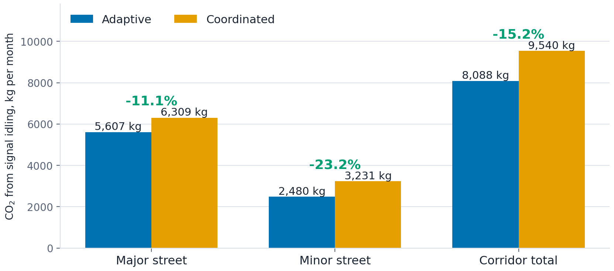
EMISSIONS
Less idling buys 15% less signal-attributable CO₂
−15.2%
Corridor CO₂ from signal idling
11.1% major, 23.2% minor
1,453 kg
CO₂ avoided in the month
1.45 metric tons
163 gal
Fuel not burned at the stop bar
654 vehicle-hours of idling
Annualized: roughly 17 metric tons CO₂ and 1,960 gallons of fuel.
Arneill Rd corridor, Camarillo CA — weekdays 07:00–19:00, Aug 14–Sep 14 2026; cycle-level signal performance data.
Notes:
Emissions here are derived from the delay data, not measured. Every second of control delay is a second of idling, so the percentage reduction in idling emissions is the percentage reduction in delay.
Weighted across the day, major-street delay fell 11.1 percent and minor-street delay 23.2 percent. Corridor-wide, weighted by the vehicles actually served, that is a 15.2 percent reduction in CO2 attributable to waiting at these four signals.
In absolute terms: about 654 vehicle-hours of idling avoided over the month, 163 gallons of fuel, and 1,453 kilograms of CO2. Annualized that is on the order of 17 metric tons.
Two things this does not say. It is not a reduction in total corridor emissions, only in the share attributable to signal delay. And it is an idling model, which the next slide unpacks.

Slide 24
HOW WE GOT THAT NUMBER
Every second of delay is a second of idling
2,353,000
654
163
1,453 kg
vehicle-seconds of
delay avoided
vehicle-hours
of idling
gallons of fuel
not burned
of CO₂
not emitted
from the delay results
divide by 3,600
× 0.25 gal per idling hour
× 8,887 g CO₂ per gallon
Same arithmetic, minor street only: 23% less idling. Major street: 11%. Weighted across the vehicles actually served, 15.2%.
What it leaves out: the extra stops on the arterial. Acceleration burns fuel too, so treat 15% as the optimistic end.
Notes:
I want this to be simple enough that you could redo it on a napkin.
Every second a vehicle waits at a signal is a second it is idling. So the emissions question is really just the delay question in different units.
We avoided about 2.35 million vehicle-seconds of delay over the month. Divide by 3,600 and that is 654 vehicle-hours of idling. A light-duty vehicle burns roughly a quarter gallon per hour idling, so 163 gallons. EPA puts 8,887 grams of CO2 in a gallon of gasoline, so about 1,453 kilograms, or 1.45 metric tons.
Four steps, and you can swap any number in the chain for your own fleet.
The honest caveat is on the right. This counts idling only. We also showed arterial arrivals on green got worse, which means more stops on the major street, and accelerating from a stop burns fuel that this method does not count. So 15 percent is the optimistic end of the range, not the middle of it.

Slide 25
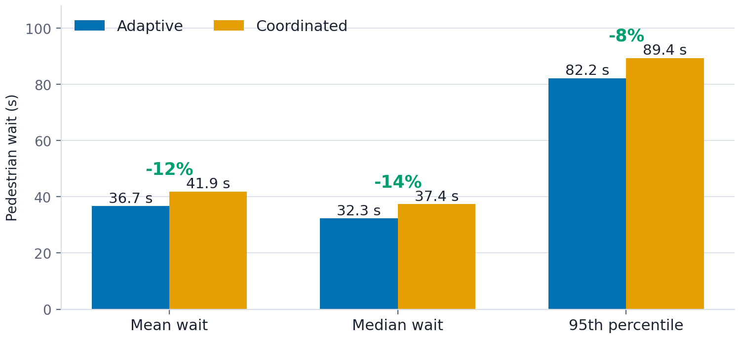
PEDESTRIANS
12% less waiting, and a shorter worst case
−5.2 s
Mean wait
41.9 s → 36.7 s
−5.1 s
Median wait
37.4 s → 32.3 s
−7.2 s
95th percentile
89.4 s → 82.2 s
17,757 pedestrian walk phases across the four signals.
Arneill Rd corridor, Camarillo CA — weekdays 07:00–19:00, Aug 14–Sep 14 2026; cycle-level signal performance data.
Notes:
Pedestrian wait measured from actuation to the walk indication, across 17,757 walk phases.
Mean wait fell 12 percent, from 41.9 to 36.7 seconds. The median moved a similar amount. The 95th percentile, the wait that drives people to cross against the signal, fell about 8 percent.
This follows directly from cycle length. Adaptive is running shorter cycles, and pedestrian wait is bounded by cycle length. It is a benefit the agency gets without any pedestrian-specific configuration.

Slide 26
PER-INTERSECTION RESULTS
Every location improved. Daily Dr gained the most.
Intersection | Delay, s adaptive | Delay, s coord. | Change | Relative change
Arneill & Barry | 22.2 | 26.2 | −4.0 s | −15.3%
Arneill & Pickwick | 28.4 | 32.3 | −3.9 s | −12.1%
Arneill & Daily | 36.1 | 45.0 | −8.9 s | −19.8%
Arneill & Ponderosa | 50.0 | 55.2 | −5.2 s | −9.4%
■ Green = adaptive better
Daily Dr gains most on both counts, 8.9 s per vehicle per cycle and 19.8%. Ponderosa carries the highest baseline delay of the four and improves least in relative terms.
Arneill Rd corridor, Camarillo CA — weekdays 07:00–19:00, Aug 14–Sep 14 2026; cycle-level signal performance data.
Notes:
Per-intersection, all movements combined. Delay improved at every location, from 3.9 seconds per cycle at Pickwick to 8.9 at Daily.
Daily Drive is the standout in both absolute and relative terms, just under 20 percent. Ponderosa has the highest baseline delay of the four but the smallest relative gain, about 9 percent.
That ordering does not follow congestion level, which is worth a question: what is different about Daily. One month and four sites cannot settle it, but it is where I would look first when tuning.

Slide 27
CONCLUSIONS
Adaptive earned its keep on the Arneill test bed.
Net delay and pedestrian benefits are real.
Delay fell in all six street-class and period comparisons; pedestrian wait fell 12%.
Side-street users gained most.
19–29% less delay on minor approaches, and 23% less idling CO₂ there.
Emissions follow the delay.
15.2% less signal-attributable CO₂, about 1,453 kg and 163 gallons of fuel over the month.
Questions. And if you run adaptive, check your own fallback hours.
Notes:
To close. Adaptive control on Arneill Road delivered lower delay in every comparison we made, 12 percent less pedestrian waiting, and its largest gains went to side-street users. That delay reduction translates to about 15 percent less CO2 from signal idling, roughly 1.45 metric tons and 163 gallons of fuel over the month.
It cost us arterial progression: arrivals on green down almost four points. Those added stops are not in the emissions number, which is why I called 15 percent an upper end.
My read is that this is a tuning conversation and not a verdict on adaptive control. And whatever we change next, we can measure it the same way, from data we already have.
Happy to take questions. If you run adaptive at your agency, I would encourage you to go look at your own fallback hours; that natural experiment is probably already sitting in your data.

